Slide 1
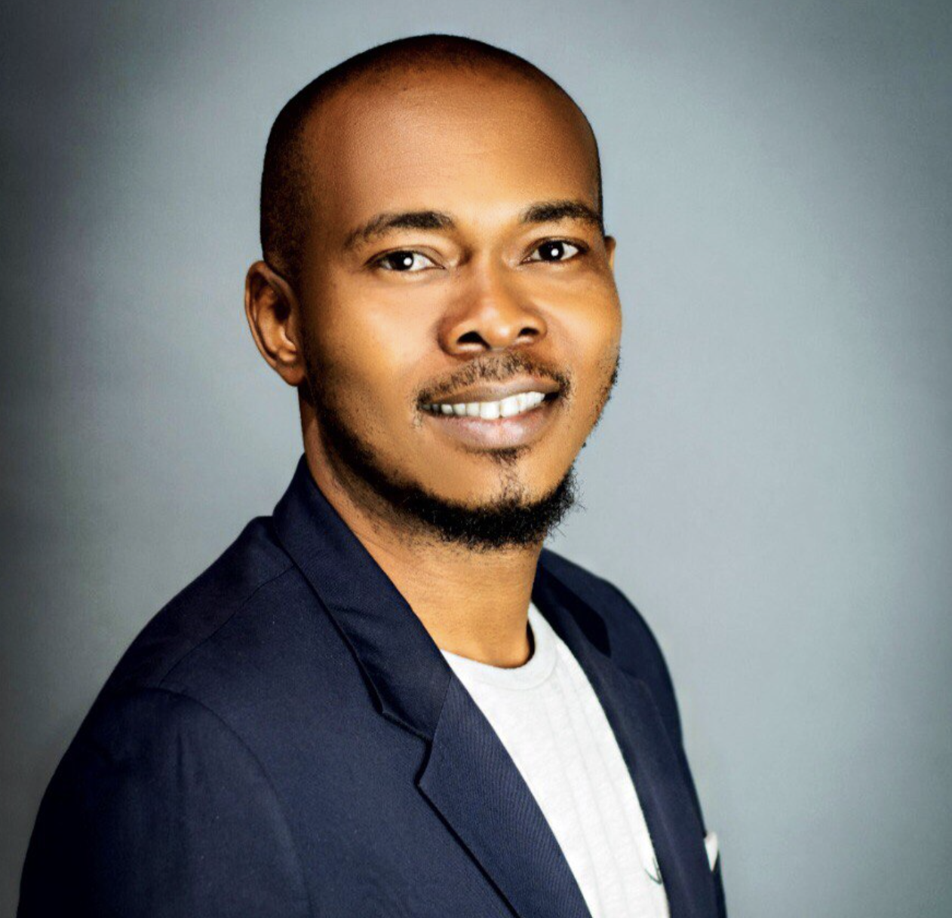
MALIK AFEGBUA : GLAMOURISING SENIORS, REINVENTING CULTURES
OPPONG EMMANUEL

Slide 2
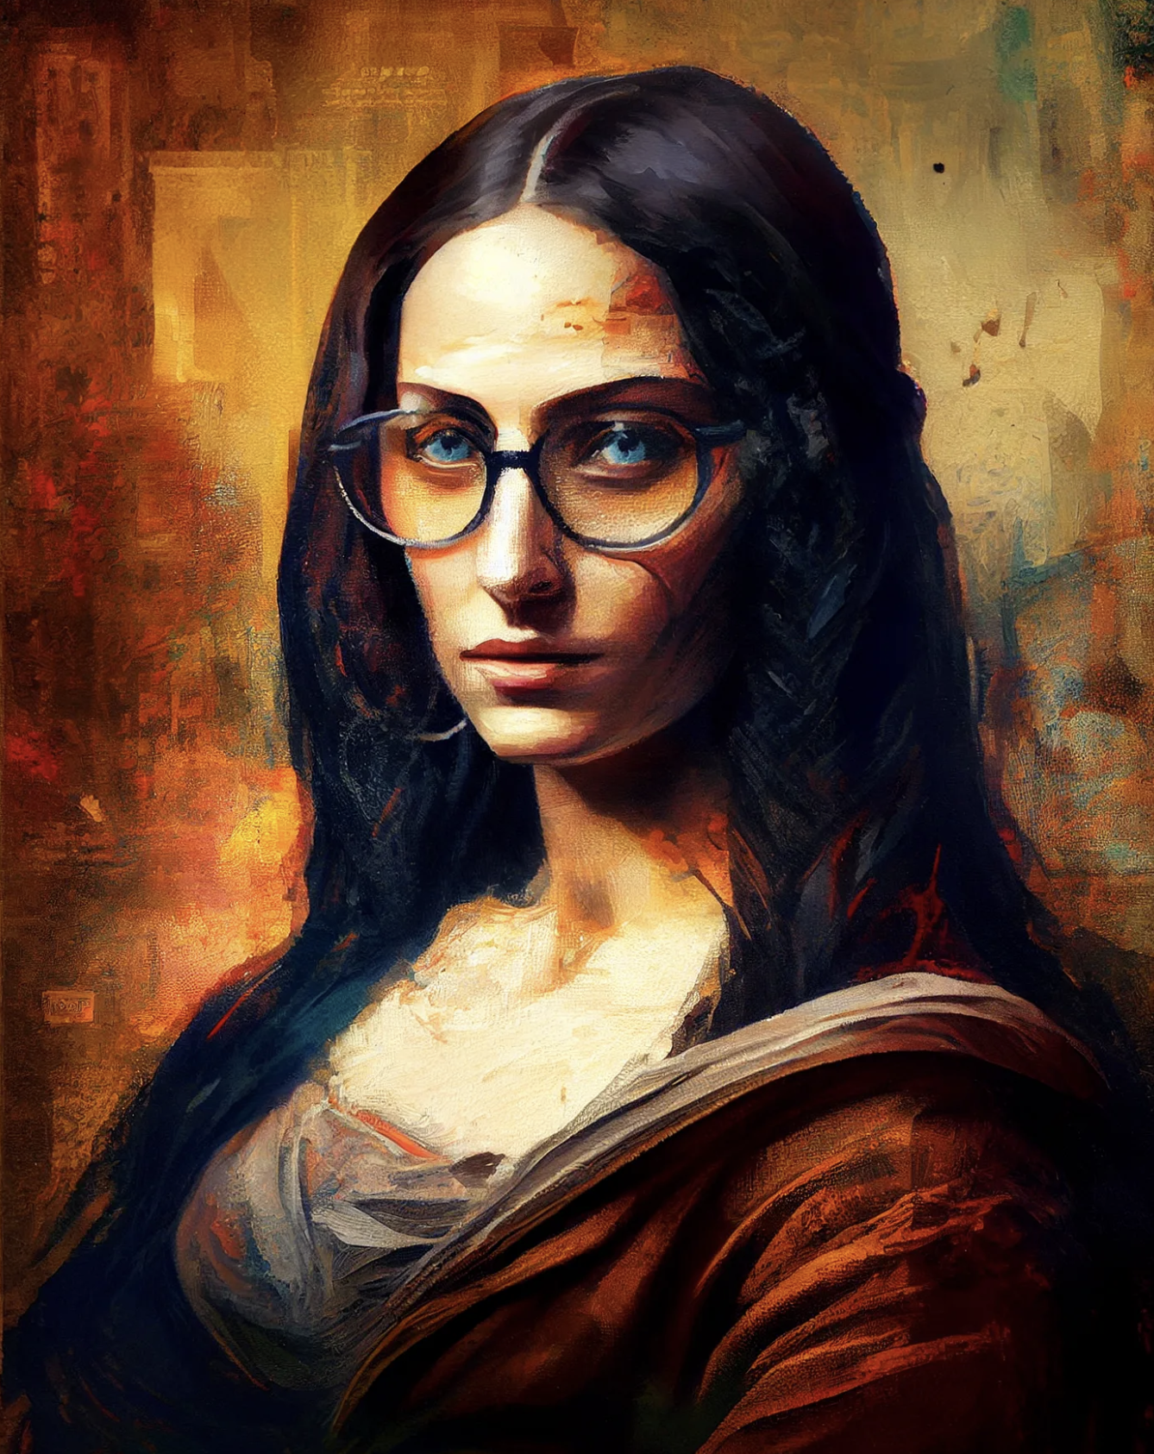
AI ART
AI Art, also known as Artificial Intelligence Art or Generative Art, refers to artwork created with the assistance of artificial intelligence techniques. It involves using algorithms, machine learning, and other AI technologies to generate or enhance artistic creations.
AI Art can take various forms, including paintings, drawings, sculptures, music, poetry, and even interactive installations. It allows artists and creative individuals to explore new possibilities and push the boundaries of traditional artistic practices.
Overall, AI Art represents an exciting intersection between technology and artistic expression, opening up new possibilities for artists, challenging traditional notions of creativity, and inviting us to explore the fascinating possibilities of human-AI collaboration in the realm of art.

Slide 3
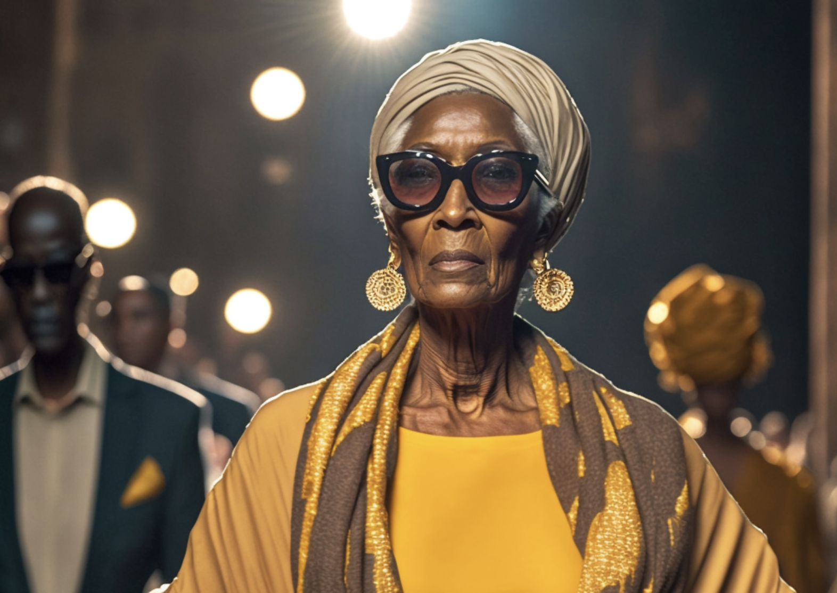
MEET MALIK
About Malik:
Malik Afegbua is the face behind SlickCity, and most recently, the brain behind the captivating AI-inspired fashion show for seniors leaving many in awe, as it continuously makes a significant impression in glamourizing old age. Speaking to Guardian Life, Afegbua talks about viewing the world through lenses and strives for intentional storytelling as the foundation of his art.
Being a filmmaker and an AI creator, how are you able to marry both worlds together? Do they inform each other independently?
For me, everything is connected because the backbone of everything I create is intentional storytelling and I like to use any creative form of expression that speaks to that point in time, I am always looking for many different ways to express myself because innovatively I always tend to find and try new tech
What will you say defines your form of expression?
Intentional storytelling is what guides my form of expression.
Let us into the creative process of your works. Looking at your collections, what inspired the fashion show for seniors, and did you expect the reception so far?
Still, on the line of intentional storytelling, the show speaks for the marginalized, exploring what could be and the possibilities of inclusion that could help in one way or the other.

Slide 4
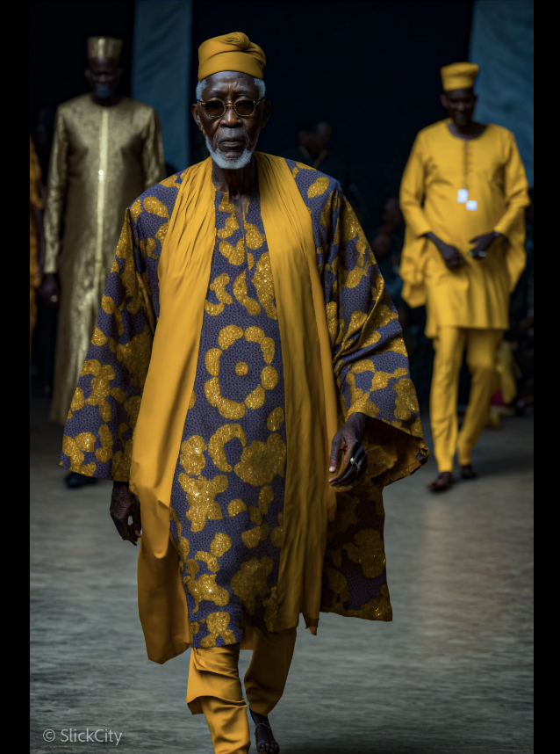
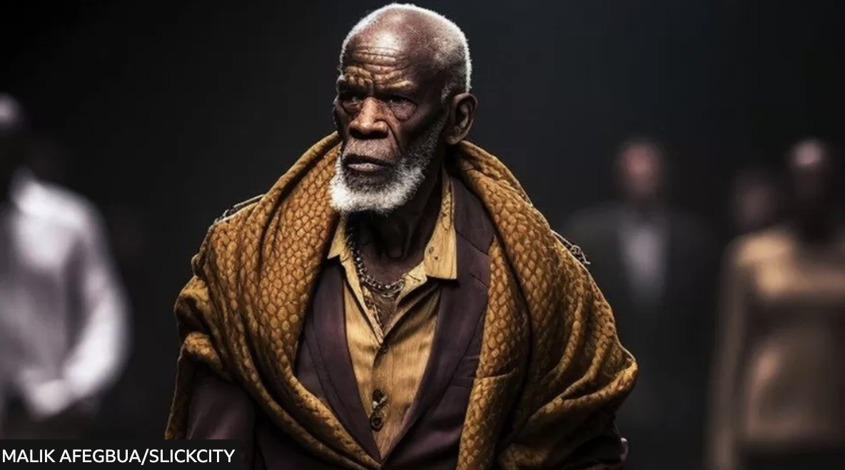
EXHIBITION OF MALIKS WORKS:
THESE AINT HUMANS, JUST AI GENERATED GRANDADAS

Slide 5
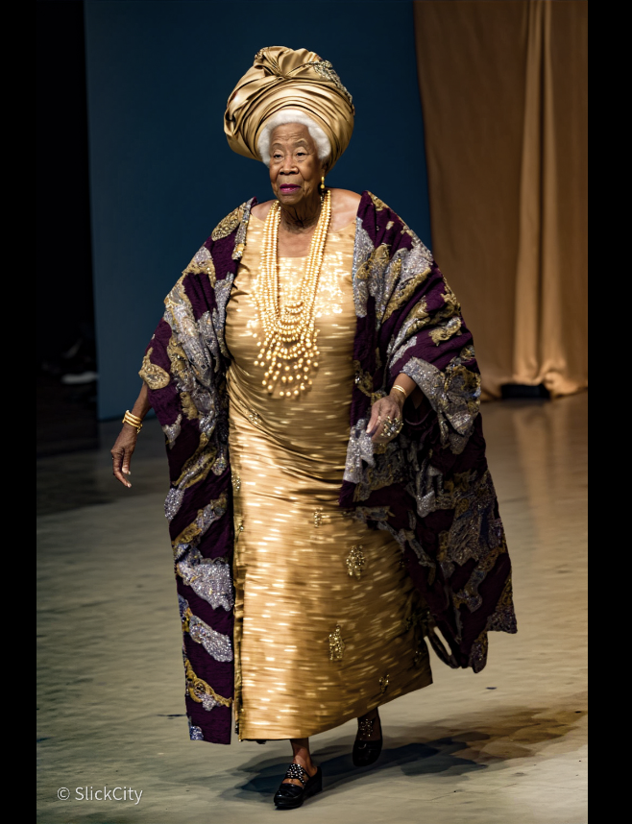
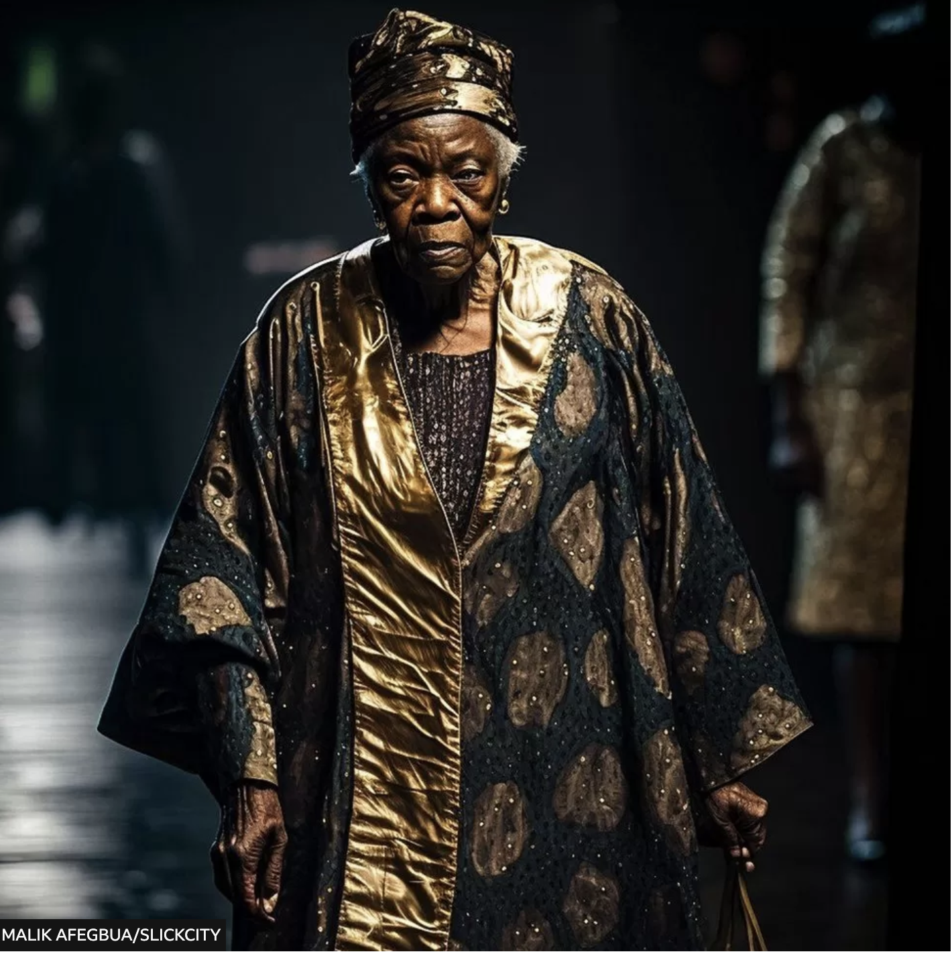

Slide 6
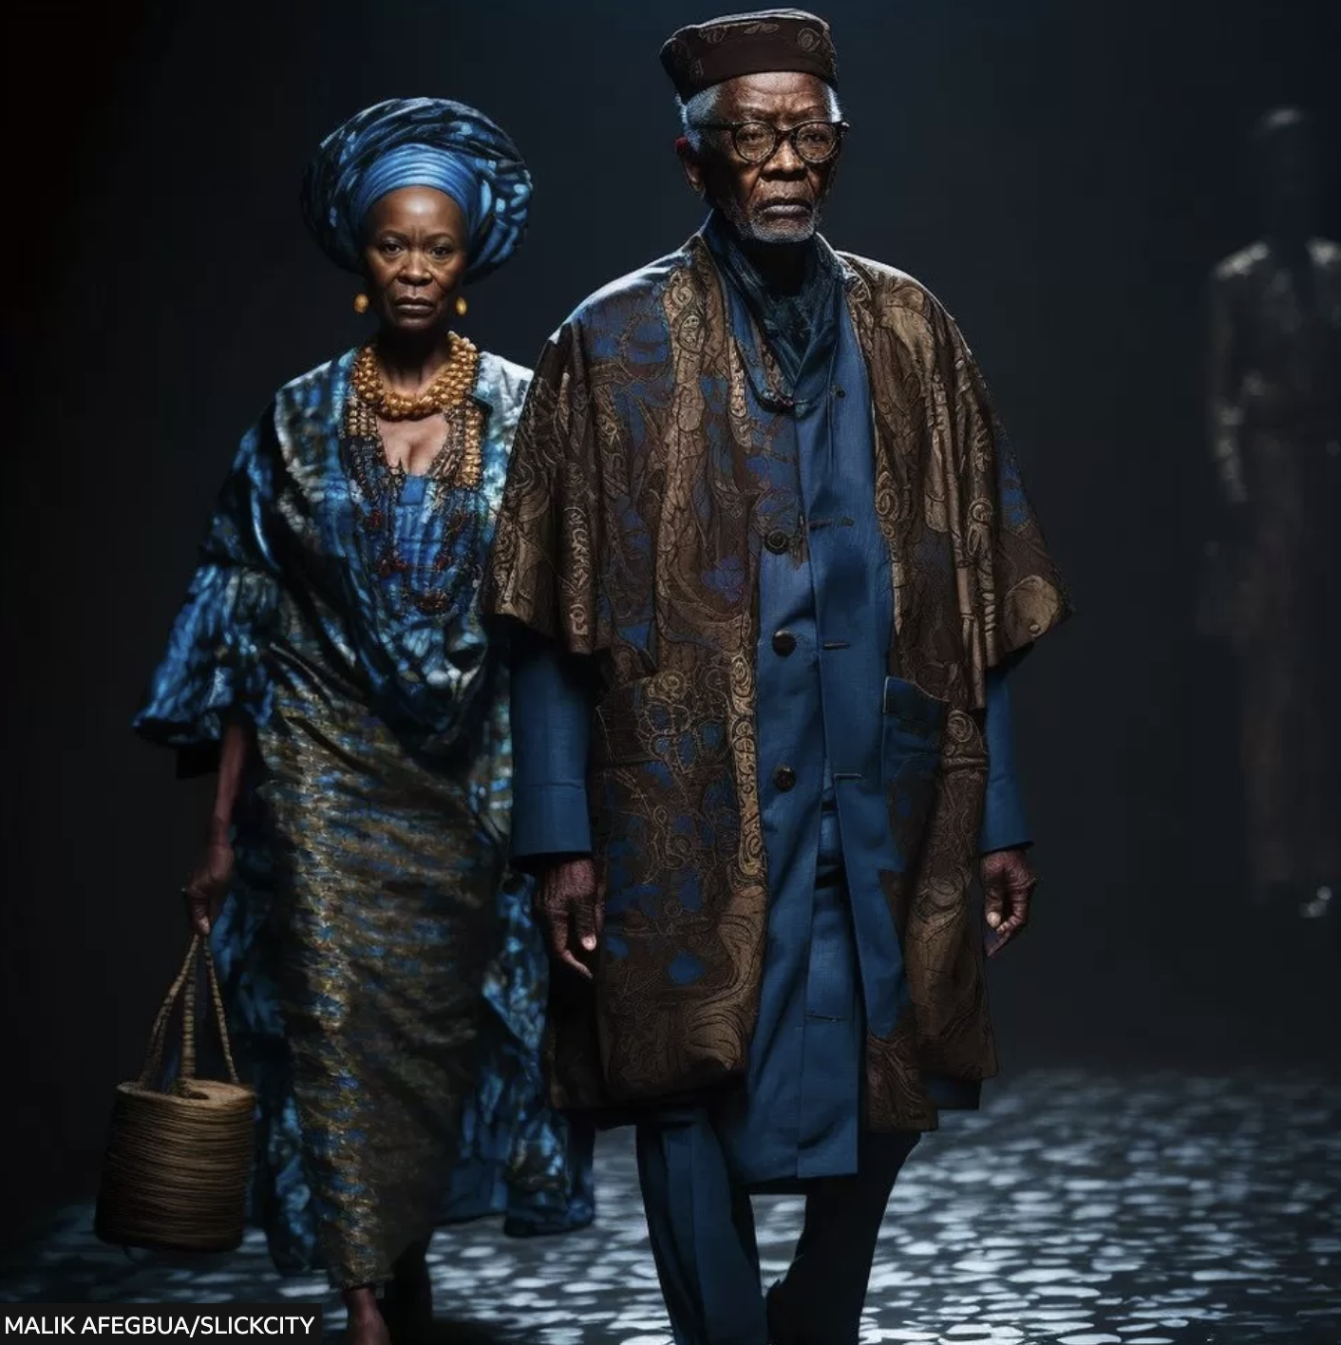
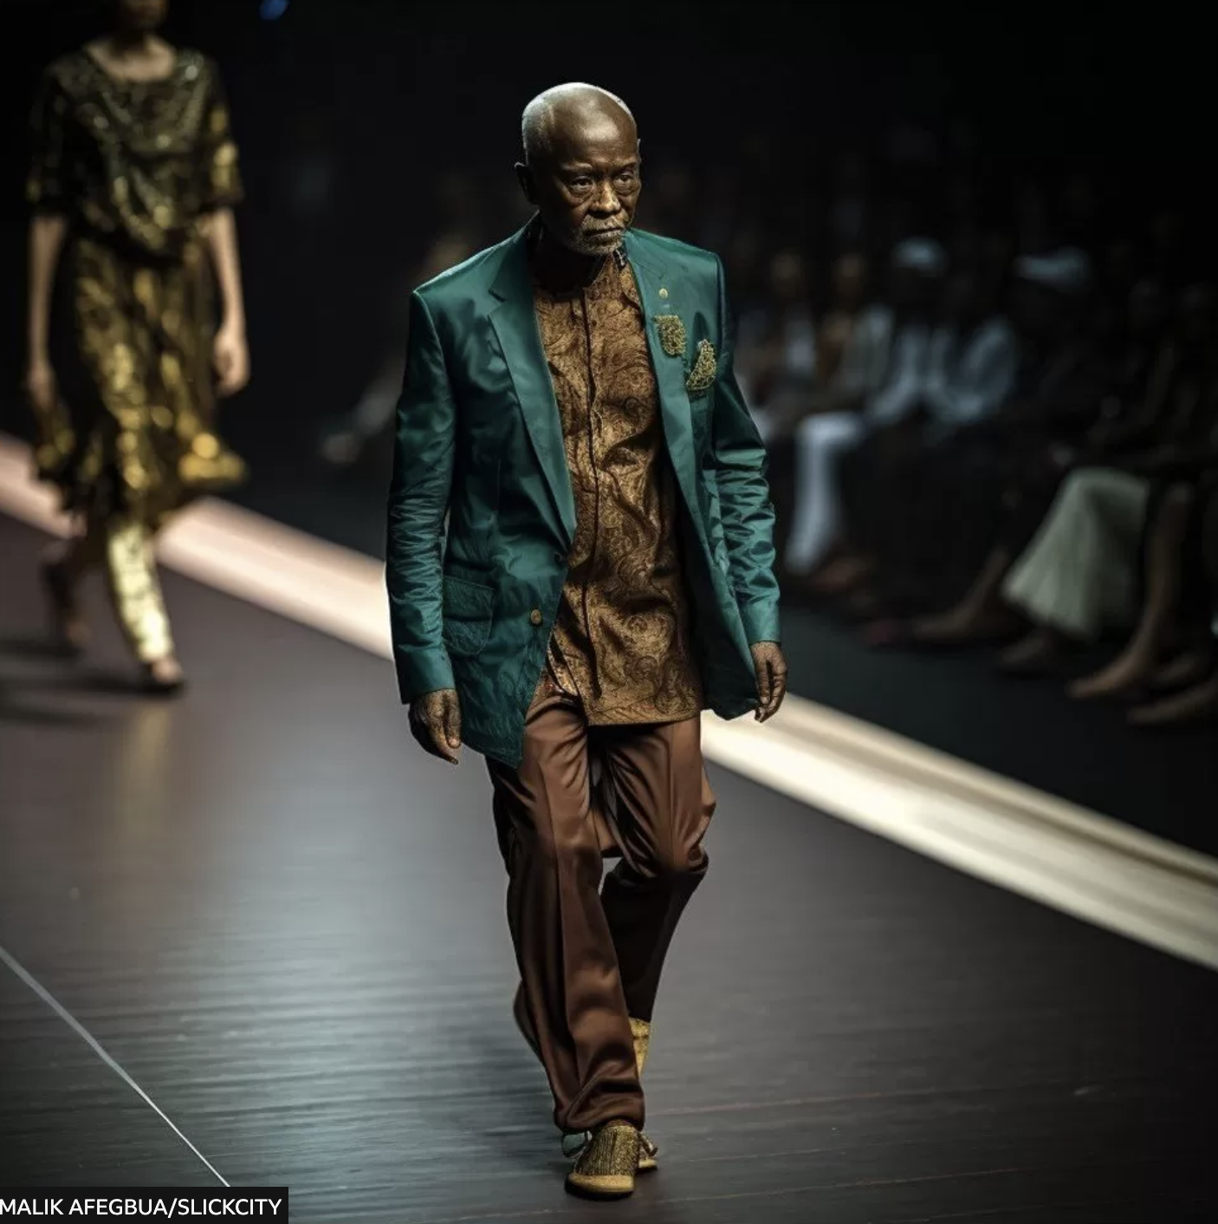

Slide 7
AI GRANDMA
SAYS THANK
YOU ALL
THE END

